Slide 1

STORYTELLING WITH TABLEAU & R SHINY IMPORTANCE OF CONTEXT & APPLICATION
By: Anubhav Rastogi
Anastasiya Krymskaya
Manvinder Kaur

Slide 2




INTRODUCTION
The project relates to the Analysis of Global TB Burden Estimates.
The dataset represents the TB statuses and other related attributes across the different nations of the world.
The dataset includes 5120 rows and 47 columns.
We used Tableau to create multiple dashboards combined together to form a story.
We used Rstudio to generate the graphs and reactive applications.
Further, we have used certain R libraries such as shiny, readxl and ggplot to prepare graphical representation of our analysis and findings.

Slide 3
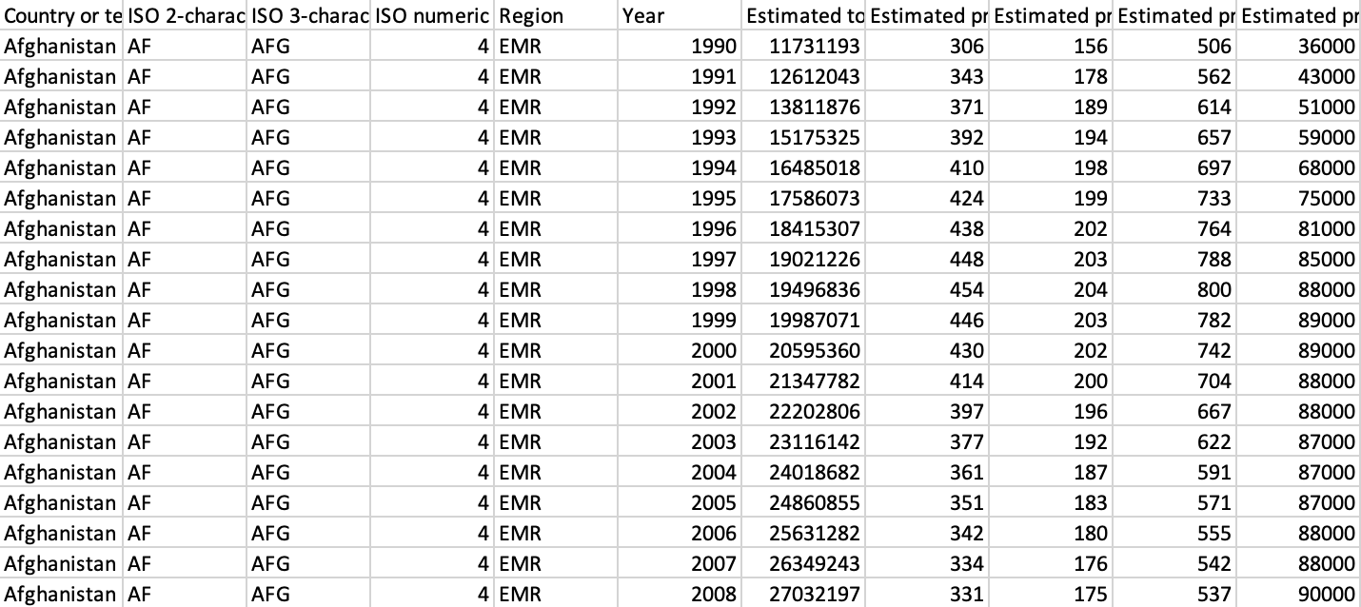
Variables
Year
Mortality
Prevalence
Death
Incidences
Country
Region
Case Detection Rates
VARIABLES USED FOR ANALYSIS
SCREENSHOT OF TUBERCULOSIS DATASET

Slide 4

QUESTIONS ASKED ?
Is there any correlation/pattern between Incidence and Mortality of TB cases (all forms) per 100,000 Population?
Is there any correlation/pattern between Prevalence and Mortality of TB cases per 100,000 population?
What are the prevalent methods to derive incidence estimates?
Is there any correlation/pattern between Incidence and Mortality of TB cases (HIV+) per 100,000 Population?
Is there any correlation/pattern between Incidence and Prevalence of TB cases?
Is there any correlation/pattern associated with estimated HIV (-) TB deaths and estimated HIV (+) TB deaths?
Is there any correlation/pattern associated with estimates of HIV (+) TB cases?
What are the countries with the highest percent of HIV(+) TB incidents ?
What is the prevalent method to derive mortality estimates?

Slide 5


A FEW MORE QUESTIONS ASKED ?
What is the prevalent method to derive prevalence estimates?
What are the regions with the highest percent of case detection?
What are the country wise mortality estimates in the year 2013?
What are the country wise Prevalence estimates per 100,000 population in the years 1990-2013?
What are the top 10 countries with HIV (-) TB Deaths of all forms?
What are the top countries with HIV (+) TB deaths of TB?
Is there any pattern between deaths and estimated mortality per 100,000 population of TB (all forms)?
Is there any pattern associated with estimated incidence (all forms) per 100,000 population?

Slide 6

FINDINGS AND ANALYSIS
The mortality has become lower, that is a positive sign. The lowest mortality is in Norway, United States and Canada. The highest mortality of TB is in Somalia, Nigeria and Cambodia.
Mostly, throughout the world, the median value of estimated incidence per 100,000 population is 61.
Deaths of Tuberculosis are positively correlated with HIV(+) results. The countries with the highest percentage of HIV+ incidents are Zimbabwe, Malawi and Zambia.
There is a positive correlation between incidence and mortality. Even, the prevalence and mortality are positively correlated, the correlation is stronger, as incidence is newly detected cases and prevalence includes people who were diagnosed in the past.

Slide 7
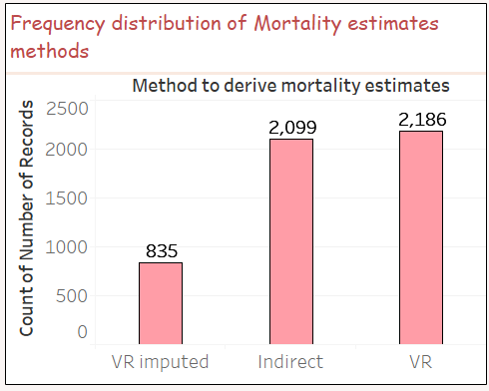
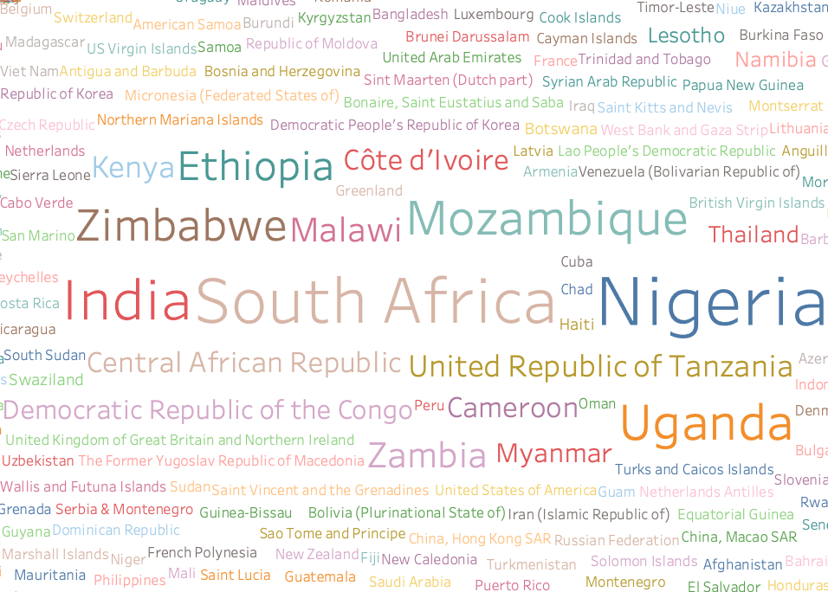
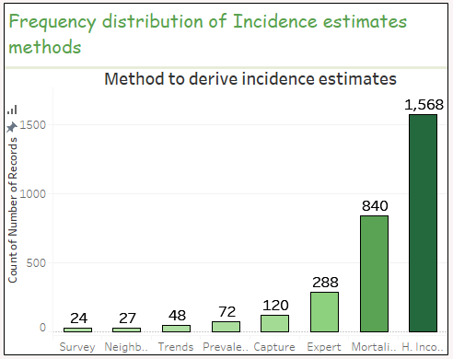
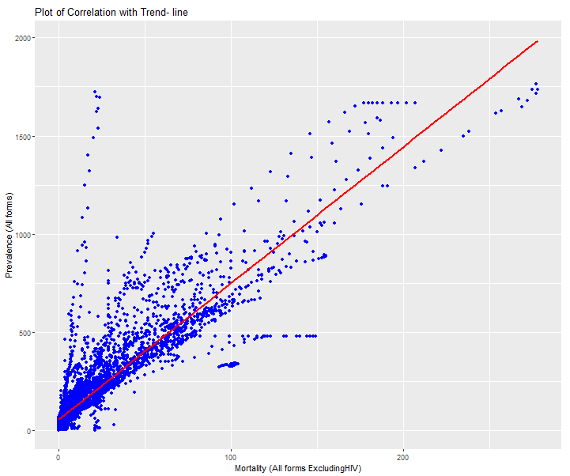
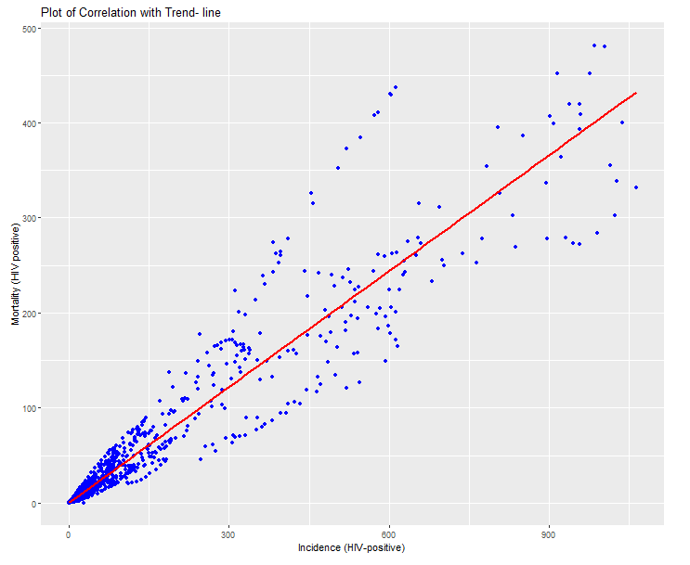
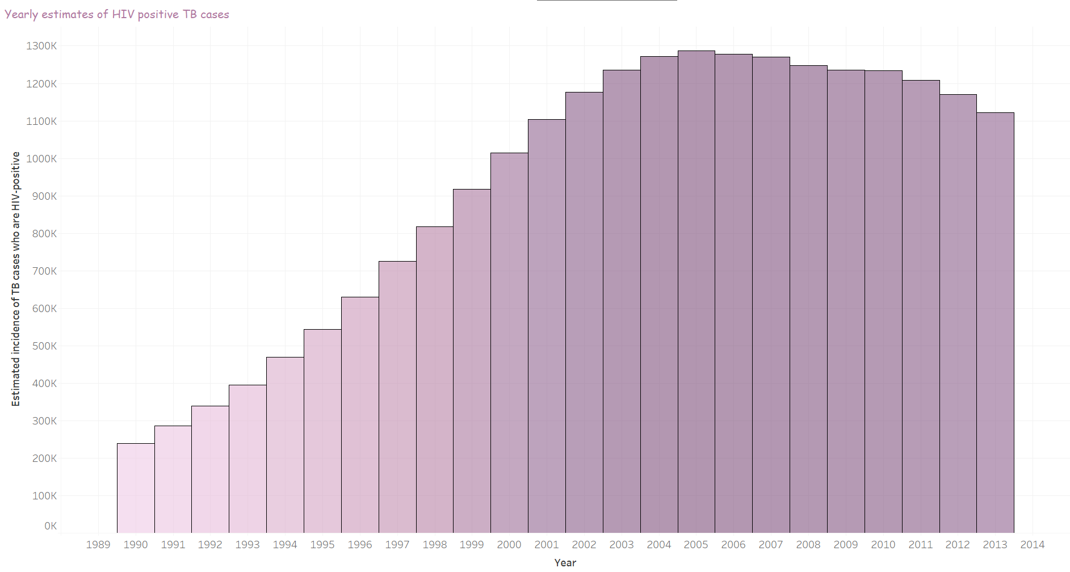
Chart reflecting word cloud of top countries with HIV (+) TB Deaths
Chart reflecting prevalent method to derive mortality estimates
Chart reflecting prevalent methods to derive incidence estimates
Some Important Visualizations
There exists a strong correlation between Prevalence and mortality of TB cases
There is a strong correlation between Incidence and Mortality of TB cases
Chart reflecting the pattern associated with estimates of HIV positive TB cases

Slide 8
Term | Value | StdErr | t-value | p-value
Estimated incidence (all forms) per 100 000 population | 0.128825 | 0.0017749 | 72.5833 | < 0.0001
intercept | 3.28506 | 0.448903 | 7.31796 | < 0.0001
Term | Value | StdErr | t-value | p-value
Estimated incidence of TB cases who are HIV-positive per 100 000 population | 0.405872 | 0.0025678 | 158.062 | < 0.0001
intercept | 0.442306 | 0.418086 | 1.05793 | 0.290194
Some Important Calculations of
R- Squared value and p-Value
Term | Value | StdErr | t-value | p-value
Estimated incidence (all forms) per 100 000 population | 1.14746 | 0.011302 | 101.527 | < 0.0001
intercept | 51.5753 | 3.06419 | 16.8316 | < 0.0001
Term | Value | StdErr | t-value | p-value
Estimated mortality of TB cases (all forms, excluding HIV) per 100 000 population | 6.87646 | 0.0571373 | 120.35 | < 0.0001
intercept | 60.7093 | 2.35907 | 25.7344 | < 0.0001

Slide 9

REFERENCES
Cole Nussbaumer Knaflic, (2015). Storytelling with data. Retrieved from http://www.bdbanalytics.ir/media/1123/storytelling-with-data-cole-nussbaumer-knaflic.pdf
Annabel Kanabus, (2018). Information about Tuberculosis. Retrieved from https://www.tbfacts.org/tb-statistics/
THANK YOU !!
HAVE A NICE DAY!!

